Slide 1


DATATECH LABS.
Data Engineering Course.
Week 3

Slide 2
Outline: Week 3
Data Warehousing and OLAP
Data warehouse architectures and design principles
Dimensional modeling and star schemas
OLAP concepts and cube operations
Data Lakes and Modern Data Architectures
Understanding data lakes and their benefits
Data lake design patterns and best practices
Introduction to Delta Lake and data lakehouse concept
DATATECH LABS.

Slide 3
Data Warehousing and OLAP
DATATECH LABS.

Slide 4
Introduction to Data Warehousing
Definition: A system used for reporting and data analysis, considered a core component of business intelligence
Purpose: To integrate data from multiple sources for complex querying and analysis
DATATECH LABS.

Slide 5
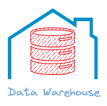
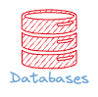
Data Warehouse vs. Operational Database
Lorem
Aspect | Data Warehouse | Operational Database
Purpose | Analysis and reporting | Day-to-day transactions
Data | Historical, integrated | Current, detailed
Query type | Complex, ad-hoc | Simple, predefined
Users | Analysts, executives | Clerks, managers
Size | Large (TBs to PBs) | Small to medium
DATATECH LABS.

Slide 6
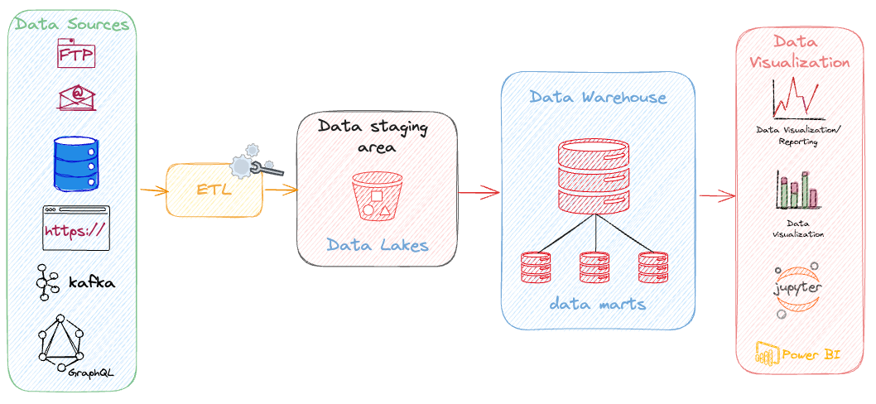
Data Warehouse Architecture
Source systems
ETL Processes
Data staging area
Data warehouse core
Data marts
Front-end data consumption tools
DATATECH LABS.

Slide 7
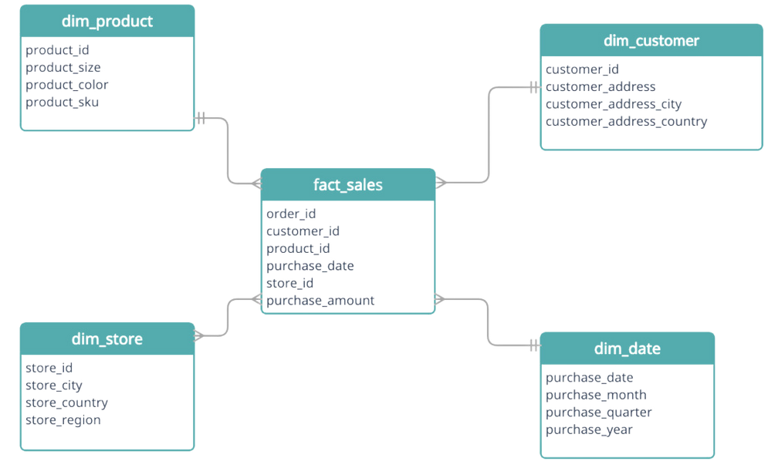
DW Schema Designs: Start & Snowflake
Star Schema: A type of database schema used in data warehousing. It consists of a central fact table connected to multiple dimension tables, resembling a star.
Structure:
Fact Table: Central table containing quantitative data (e.g., sales, revenue).
Dimension Tables: Surrounding tables with descriptive attributes (e.g., time, product, location).
Advantages:
Simpler queries
Faster performance for read operations
Easy to understand and maintain
DATATECH LABS.

Slide 8
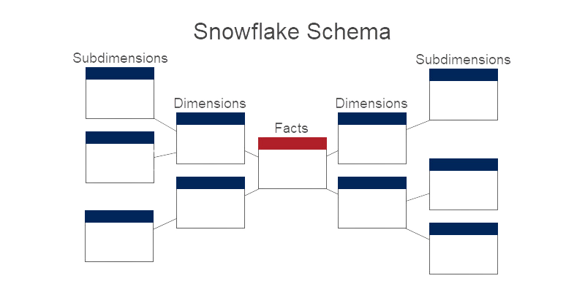
DW Schema Designs: Start & Snowflake
Snowflake Schema: A more normalized version of the star schema where dimension tables are further broken down into related sub-dimension tables.
Structure:
Fact Table: Same as in the star schema.
Normalized Dimension Tables: Hierarchically organized dimension tables.
Advantages:
Reduced data redundancy
More organized and efficient storage
Considerations:
Slightly more complex queries
May have slower query performance
compared to a star schema
DATATECH LABS.

Slide 9
Slowly Changing Dimensions (SCDs)
Type 1: Overwrite
Type 2: Add new row
Type 3: Add new attribute
Type 4: Use history table
Type 6: Hybrid approach
DATATECH LABS.

Slide 10
Data Warehouse Implementation Approaches
Top-down approach (Inmon)
Bottom-up approach (Kimball)
Hybrid approach
DATATECH LABS.

Slide 11
Intro to OLAP (Online Analytical Processing)
Definition: Technology for analyzing multidimensional data from multiple perspectives
Key operations: Slice, dice, drill-down, roll-up, pivot
OLAP Cube:
Dimensions
Measures
Hierarchies
DATATECH LABS.

Slide 12

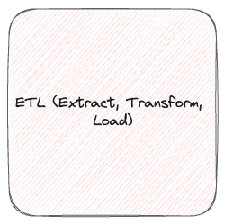
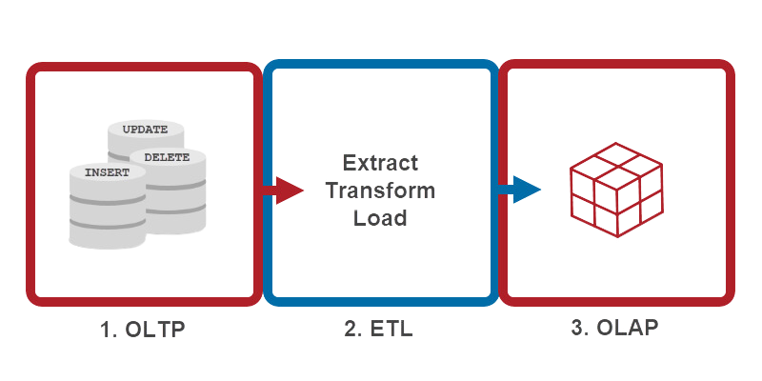
OLTP vs. OLAP
OLTP (Online Transaction Processing)
OLAP (Online Analytical Processing)
Transactional
Analytical
Aspect | OLAP | OLTP
Purpose | Analysis and reporting | Transaction processing
Data updates | Periodic, batch updates | Continuous updates
Queries | Complex, ad-hoc | Simple, standardized
Data view | Multidimensional | Flat relational
Data volume | Large | Moderate
DATATECH LABS.

Slide 13
Data Warehouse Design Process
Requirements gathering
Dimensional modeling
Physical design
Data staging design
ETL design and development
DATATECH LABS.

Slide 14
Data Warehouse Performance Tuning
Indexing strategies
Partitioning
Materialized views
Query optimization
DATATECH LABS.

Slide 15
Security in Data Warehousing
Access control
Data encryption
Auditing and monitoring
Compliance considerations (e.g., GDPR, HIPAA)
DATATECH LABS.

Slide 16
Popular Data Warehouse Technologies
Modern Data Warehouses:
Amazon Redshift
Google BigQuery
Snowflake
Azure Synapse Analytics
Teradata
Modern Data Warehouse Trends
Cloud-based data warehousing
Real-time data warehousing
Big data integration
Machine learning integration
DATATECH LABS.

Slide 17
Hands-on:
Data Warehousing
DATATECH LABS.

Slide 18
Q&A and Discussion
DATATECH LABS.

Slide 19
Data Lakes and Modern Data Architectures
DATATECH LABS.

Slide 20
Introduction to Data Lakes
Definition: A centralized repository that allows you to store all your structured and unstructured data at any scale
Purpose: To store raw data for future processing and analysis
DATATECH LABS.

Slide 21
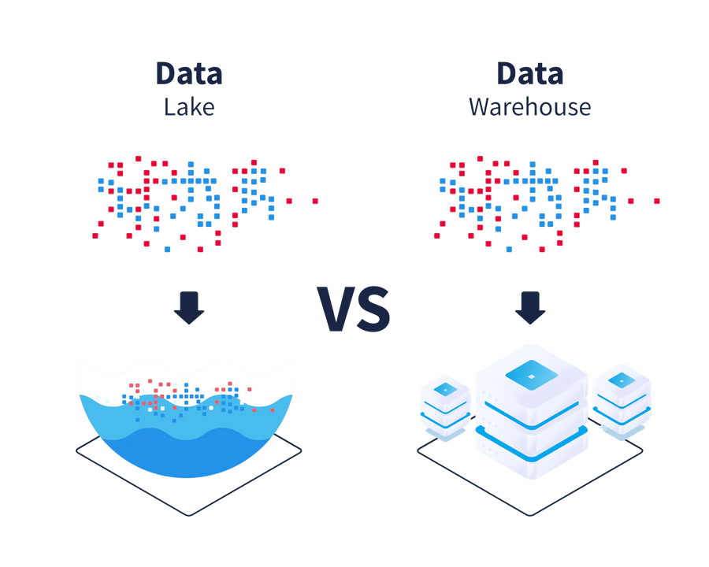
Data Lake vs. Data Warehouse
Lorem
Aspect | Data Lake | Data Warehouse
Data structure | Raw, unstructured/semi-structured | Processed, structured
Schema | Schema-on-read | Schema-on-write
Users | Data scientists, analysts | Business analysts
Agility | Highly flexible | Less flexible
Processing | ELT (Extract, Load, Transform) | ETL (Extract, Transform, Load)
DATATECH LABS.

Slide 22
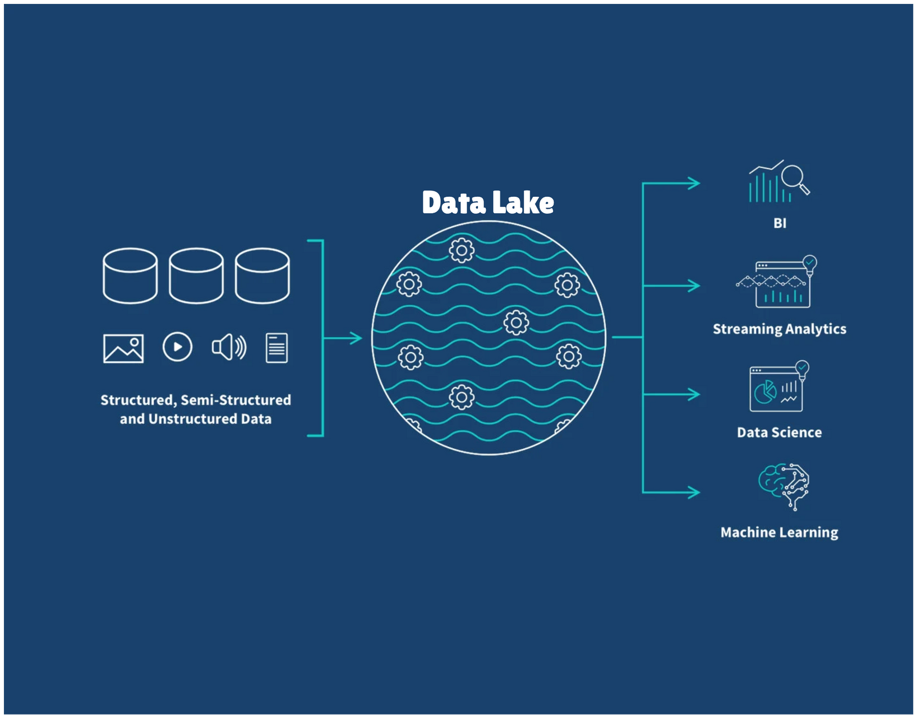
Data Lake Architecture
Data Sources
Ingestion Layer
Storage Layer
Processing Layer
Consumption (Data access) Layer
DATATECH LABS.

Slide 23
Data Lake Storage Technologies
Hadoop Distributed File System (HDFS)
Cloud object storage (e.g., Amazon S3, Azure Blob Storage, Google Cloud Storage)
Delta Lake
Apache Hudi
Apache Iceberg
DATATECH LABS.

Slide 24
Data Ingestion in Data Lakes
Batch ingestion
Stream ingestion
Change Data Capture (CDC)
Data migration tools
Data Formats in Data Lakes:
CSV
JSON
Avro
Parquet
ORC (Optimized Row Columnar)
DATATECH LABS.

Slide 25
Data Processing in Data Lakes
Batch processing (e.g., Hadoop MapReduce, Spark)
Stream processing (e.g., Spark Streaming, Flink)
Interactive queries (e.g., Presto, Impala)
Machine learning pipelines
DATATECH LABS.

Slide 26
Data Governance in Data Lakes
Metadata management
Data lineage
Access control and security
Data quality management
Data lifecycle management
DATATECH LABS.

Slide 27
Challenges in Data Lake Implementation
Data swamp prevention
Schema evolution
Data quality issues
Performance optimization
Cost management
DATATECH LABS.

Slide 28
Data Lakehouse Concept
Definition: A new data management paradigm that combines the best elements of data lakes and data warehouses
Key features:
ACID transactions
Schema enforcement
BI support
Decoupled storage and compute
DATATECH LABS.

Slide 29
Delta Lake
Open-source storage layer for data lakes
Key features:
ACID transactions
Scalable metadata handling
Time travel (data versioning)
Schema enforcement and evolution
Audit history
DATATECH LABS.

Slide 30
Modern Data Architecture Patterns
Lambda Architecture:
Batch layer
Speed layer
Serving layer
Kappa Architecture:
Stream processing as the core
Reprocessing capabilities
Unified Architecture (Data Lakehouse)
DATATECH LABS.

Slide 31
Data Mesh Architecture
Definition: A decentralized socio-technical approach to data management
Key principles:
Domain-oriented decentralized data ownership
Data as a product
Self-serve data infrastructure
Federated computational governance
Discussion: the trade-offs between centralized (e.g., data lake) and decentralized (e.g., data mesh) approaches to data architecture.
DATATECH LABS.

Slide 32
Implementing Data Quality in Modern Architectures
Data profiling
Data validation rules
Anomaly detection
Data quality scorecards
Automated data cleansing
DATATECH LABS.

Slide 33
Future Trends in Data Architectures
AI-driven data management
Edge computing and IoT integration
Blockchain for data integrity
Quantum computing for data processing
DATATECH LABS.

Slide 34
Hands-on:
Data
DATATECH LABS.

Slide 35
Q&A and Discussion
DATATECH LABS.

Slide 36

MEET OUR TEAM
Omar AlSaghier
Sr. Data Engineer
DATATECH LABS.

Slide 37







DATATECH LABS.
THANK YOU
OUR CONTACT
DataTechLabs
datatechlabs.ai@gmail.com
datatechlabs.ai
Amman, Jordan

Slide 38
What
DATATECH LABS.

Slide 39
template
Lorem
DATATECH LABS.

